Slide 1
lisov@alexEY:~$ Hello, Today I want to tell you about some types of viruses

Slide 2


Slide 3
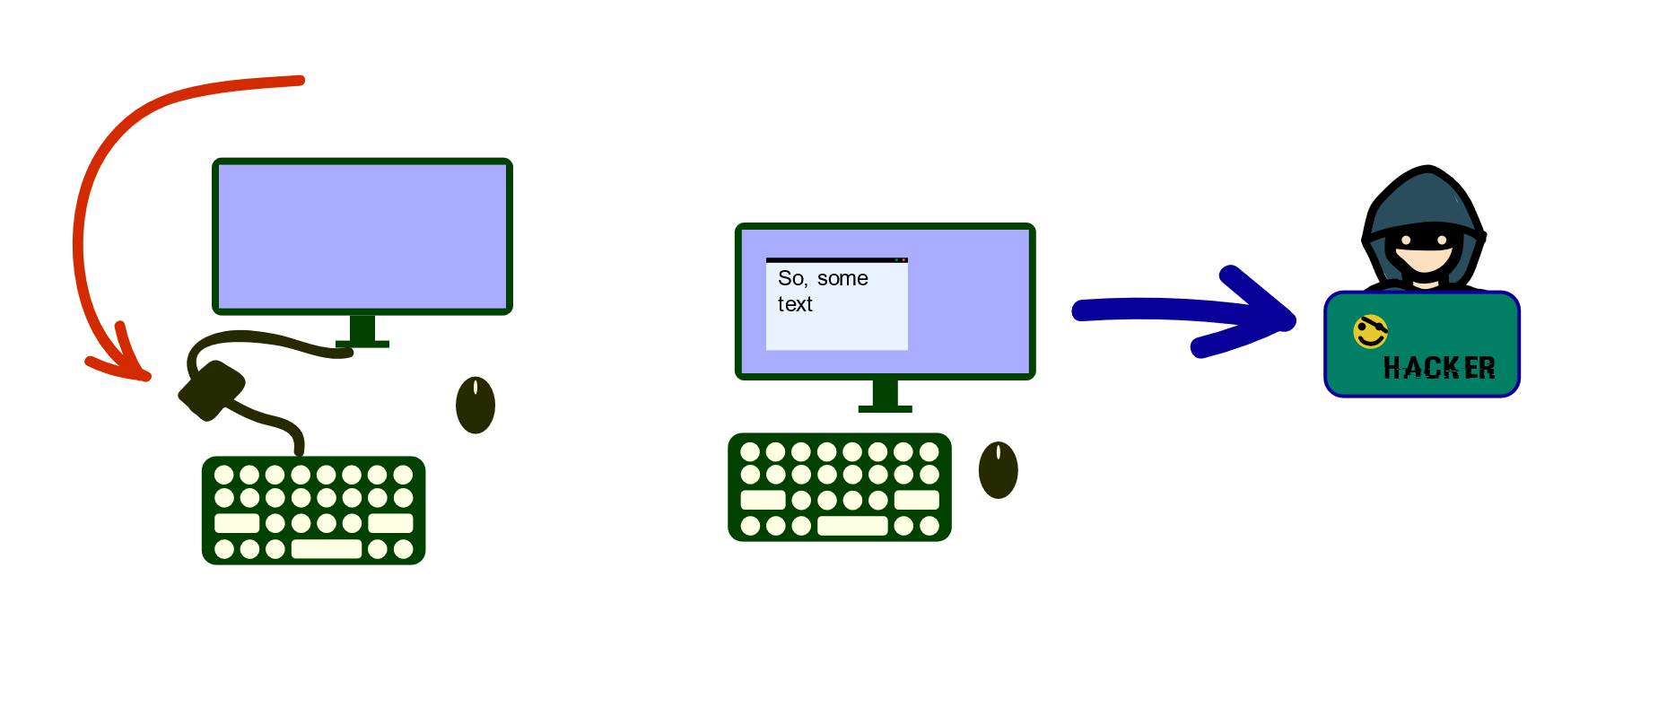
KEylogger

Slide 4
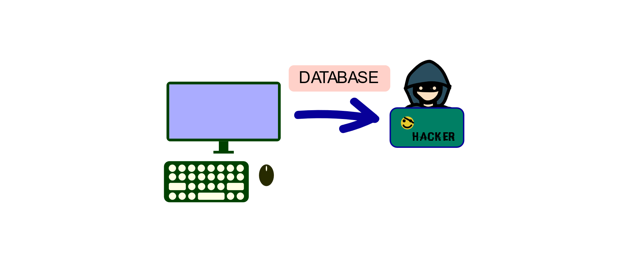
STEALEr

Slide 5

winlocker

Slide 6
Goodbye. . . . . . . .

